Slide 1
Protein Structure Prediction Using Mutually Orthogonal Latin Squares and a Genetic Algorithm
J. Arunachalam, V. Kanagasabai and N. Gautham.
Biochemical and Biophysical Research Communications,
Vol. 342, pp. 424~433, 2006.
Presenter : Hsiao-Yen Chang
Date : December 26, 2007

Slide 2
Abstract
We combine a new, extremely fast technique to
generate a library of low energy structures of an
oligopeptide with a genetic algorithm to predict protein
structures. The protein sequence is divided into
oligopeptides, and a structure library is generated for
each. These libraries are used in a newly defined
mutation operator that, together with variation,
crossover, and diversity operators, is used in a
modified genetic algorithm to make the prediction.
Application to five small proteins has yielded near
native structures.

Slide 3
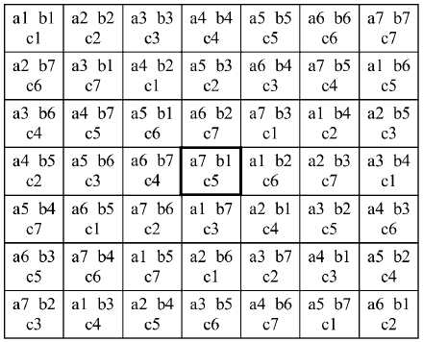
The MOLS Algorithm (1/7)
A Latin square is an n × n table
filled with n different symbols in
such a way that each symbol
occurs exactly once in each row
and exactly once in each column.
There are n² triples of the form
(r,c,s), where 1 ≤ r, c, s ≤ n.
All of the pairs (r,c) are different,
all the pairs (r,s) are different,
and all the pairs (c,s) are different.
a | b | c
b | c | a
c | a | b
aα | bβ | cγ
bγ | cα | aβ
cβ | aγ | bα
α | β | γ
γ | α | β
β | γ | α
FIGURE 2 An example of a set of mutually orthogonal Latin squares, showing three MOLS of order 7, i.e., N=7, n=3, and m=7.

Slide 4
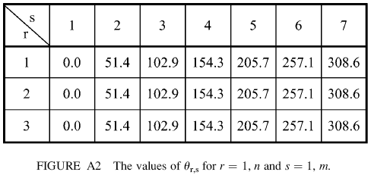
The MOLS Algorithm (2/7)
The application of the MOLS procedure to the side chain of Glutamic acid, consisting of just three variable torsion angles.
n=3, m=6 → N=7 → m=7
We have to choose the order, N, of the Latin squares as a prime number greater than the larger of n and m.

Slide 5
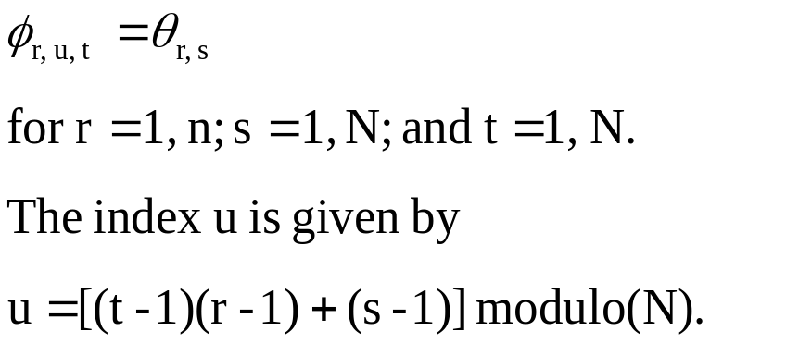
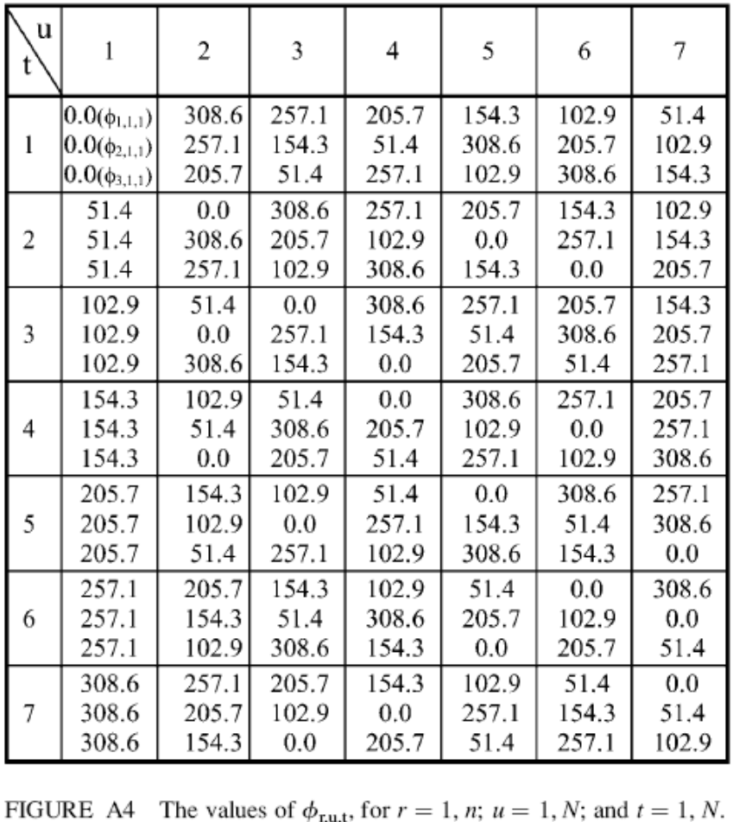
The MOLS Algorithm (3/7)

Slide 6
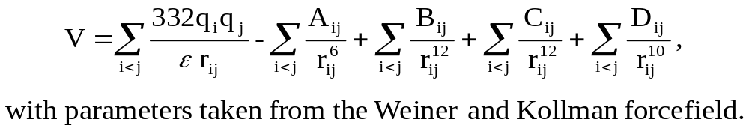
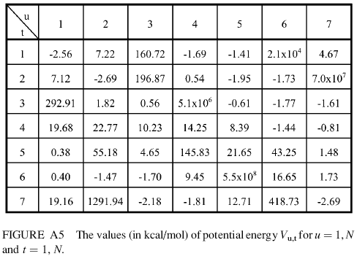
The MOLS Algorithm (4/7)
We now calculate the potential energy for each conformation.

Slide 7
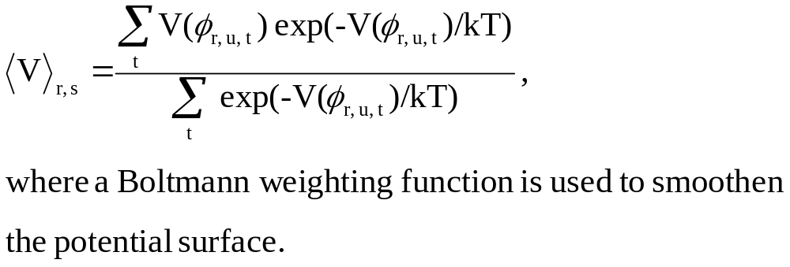
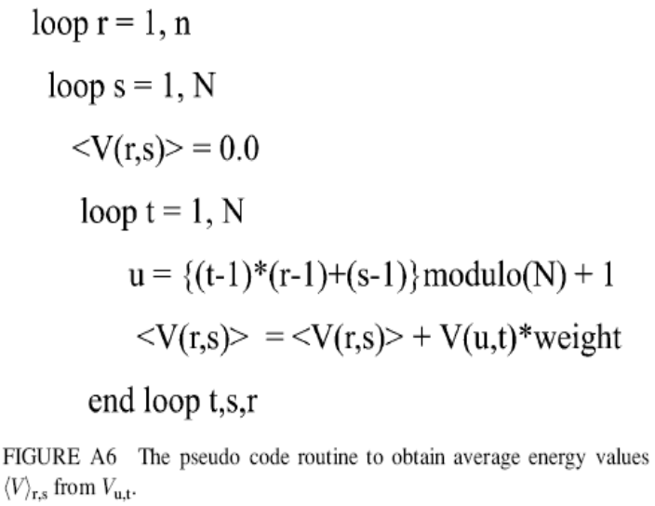

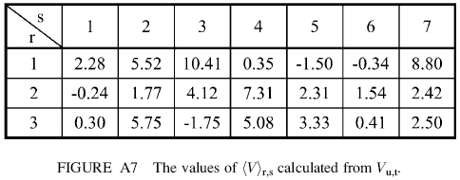
The MOLS Algorithm (5/7)

Slide 8
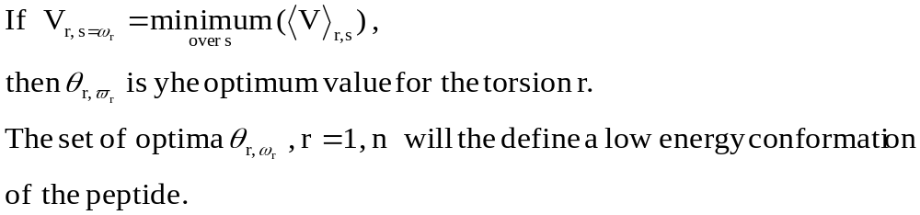
The MOLS Algorithm (6/7)
- 1.90 kcal/mol

Slide 9
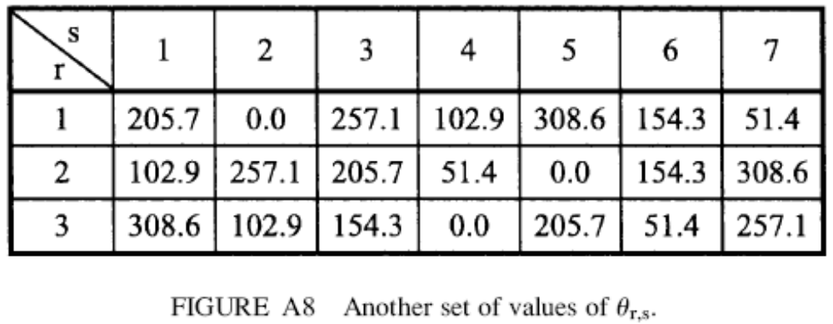
The MOLS Algorithm (7/7)
- 2.67 kcal/mol

Slide 10
Materials
avian pancreatic polypeptide (APP)《1PPT》,
villin headpiece (VHP)《1VII》,
mellitin (MEL)《1MLT》,
cMYB (MYB)《1GV5》 and
tryptophan zipper (TZ).

Slide 11
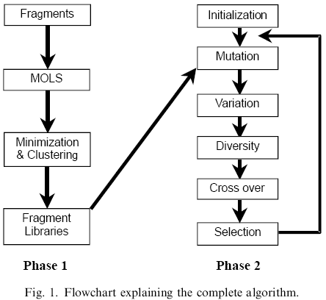
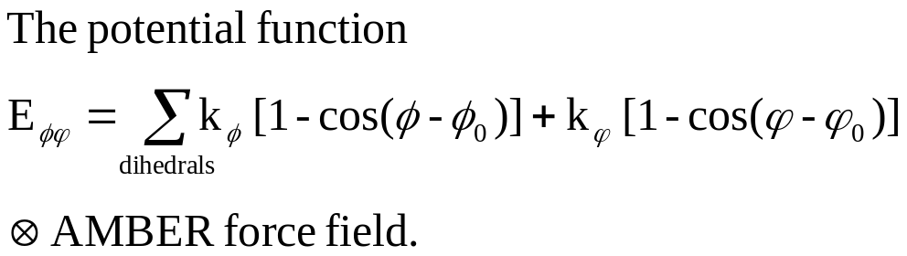
Methods
Ａ = 00000000
Ｂ = 11111111
Ａ’ = 00111000
B’ = 11000111
1
Ａ = 00000000
Ｂ = 11111111
nine residues
Ａ’ = 01010101
B’ = 10101010
2
100 (180°)
0.1
The fitness function
E_{pe} = 4 ^{△D}
where △D is the measured diameter of the structure minus the expected diameter. If the actual diameter is lesser than the expected diameter, then E_{pe} is set to zero. The diameter was measured as the largest distance between any two Cα atoms. The expected diameter was calculated as 8 x (length of the sequence in residues)^{1/3}.
The VARIATE operator increments or decrements the chosen torsion
angle by 1°, 5° or 10°.
1.0 Å RMSD
This operator randomly selects a residue and sets the backbone torsion angles of the next five residues to 180°.
1) the two-point crossover.
2) the uniform crossover.
8 to 51 hours
1 to 17 hours

Slide 12
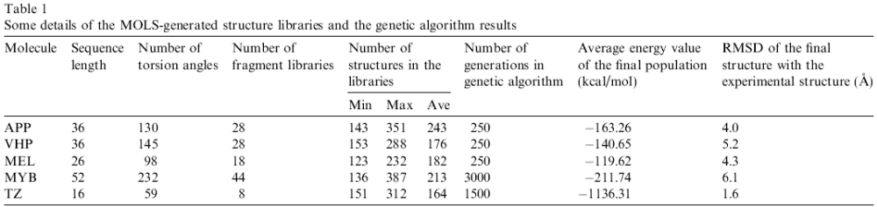
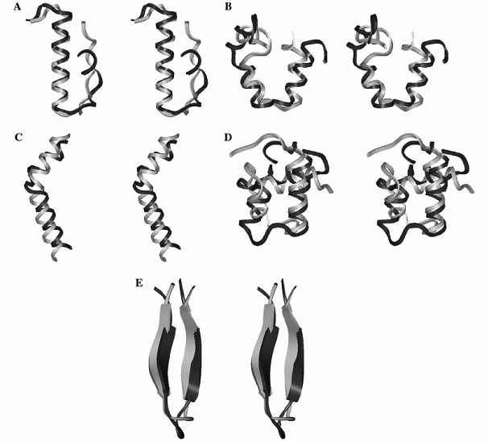
Results
Fig. 2. Stereo view of the predicted structure (dark) superposed on the experimental structure (light) of APP (A), VHP (B), MEL (C), MYB(D), and TZ (E).

